Slide 1

Alexander Antonio, Rana Alnajar, David Jones, Yashua McDougal, Claude

Slide 2
What is AutoBookr ?
AutoBookr is a mechanic scheduling platform that connects customers with local mechanics and facilitates the booking process.

Slide 3
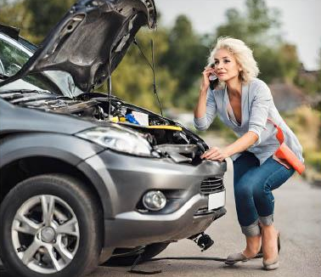
Meet Sarah
Sarah is a single mother.
Her car does not start and needs assistance.
She needs to find a local mechanic nearby.

Slide 4
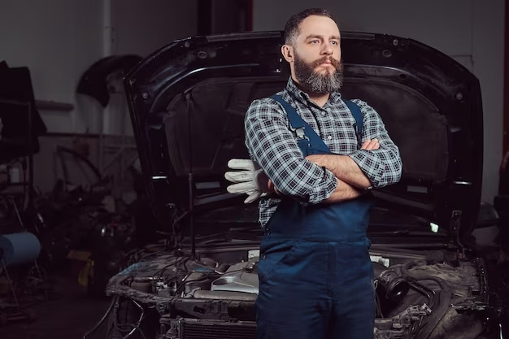
Meet Bob
Bob is a local mechanic.
Struggles with incoming calls.
Needs a way to keep track of his appointments.

Slide 5
Meet Will
Will is a popular mechanic in the area.
Each day he gets many cars in the lot.
He needs to find a better way to work on a single vehicle for a certain time.

Slide 6
How does it work ?
Customer Side
Register / login page
Home page
Find mechanic
State car issue
Select a date and time that is available
Confirm appointment

Slide 7
How does it work ?
Mechanic side
Register / login page
Shows schedule
Message the customer

Slide 8
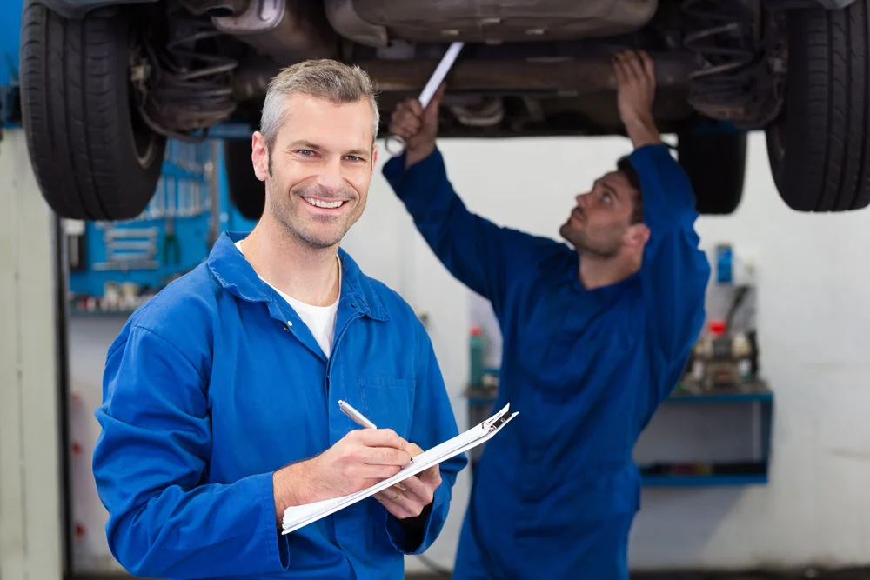
Benefits for Customers:
Offer an emergency booking feature for urgent vehicle issues.
Provide a feature that sends customers a reminder.
Discounts for repeat customers.
A user review section where customers can share their experiences

Slide 9
Questions?

